Slide 1
ASP Dot NET Core Concepts

Slide 2
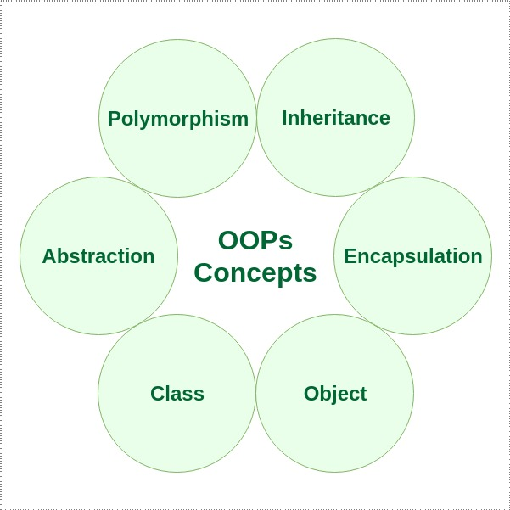
Object and Object Oriented Programming

Slide 3
OOP Concept
object-oriented programming is about creating objects that contain both data and methods.
It is programming model where programs are organized around objects and data.
Object-oriented programming has several advantages over procedural programming:
OOP is faster and easier to execute
OOP provides a clear structure for the programs
OOP helps to keep the C# code DRY "Don't Repeat Yourself", and makes the code easier to maintain, modify and debug
OOP makes it possible to create full reusable applications with less code and shorter development time

Slide 4
Class and Object
Class is a template for objects, and an object is an instance of a class
Class
Fruit
Objects
Apple
Banana
Mango
Fruit objFruit = new Fruit();

Slide 5
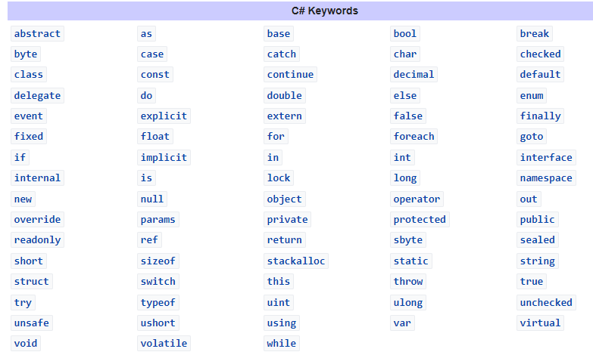
Keywords
Keywords are predefined, reserved identifiers that have special meanings to the compiler

Slide 6
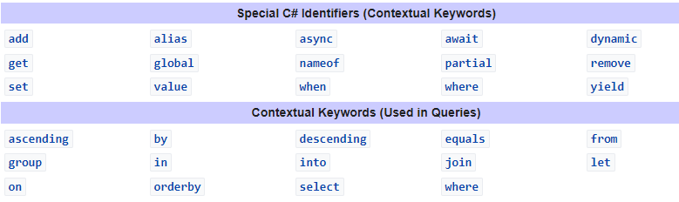
Contextual keyword is used to provide a specific meaning in the code, but it isn't a reserved word in C#.

Slide 7
Variables
int - stores integers (whole numbers), without decimals, such as 123 or -123
double - stores floating point numbers, with decimals, such as 19.99 or -19.99
char - stores single characters, such as 'a' or 'B'. Char values are surrounded by single quotes
string - stores text, such as "Hello World". String values are surrounded by double quotes
bool - stores values with two states: true or false

Slide 8
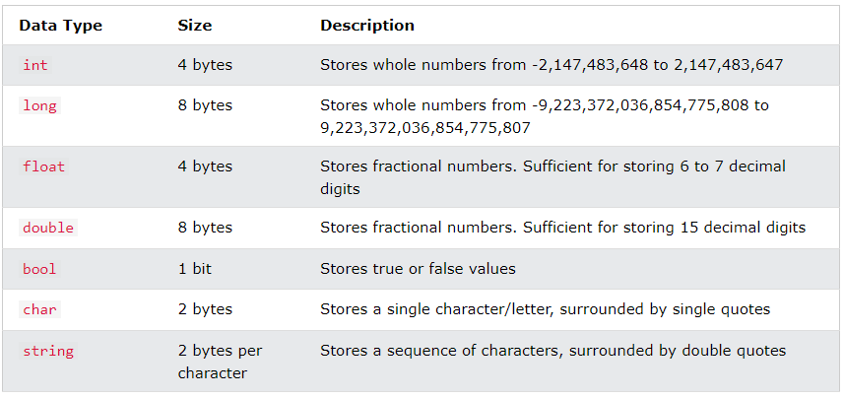
Data Types

Slide 9
Type Casting/Conversion
Type casting is when you assign a value of one data type to another type.
In C#, there are two types of casting:
Implicit Casting (automatically) - converting a smaller type to a larger type size char -> int -> long -> float -> double eg. int myInt = 9; double myDouble = myInt; Output: myInt=9, myDouble=9
Explicit Casting (manually) - converting a larger type to a smaller size type double -> float -> long -> int -> char
eg. double myDouble = 9.78; int myInt = (int) myDouble; Output: myDouble = 9.78, myInt =9

Slide 10
ORM
Makes easier to write code that interacts with database by adding layer of abstraction between code and database
Entity Framework Core used default ORM used by Microsoft

Slide 11
Lifetime of Services
Scoped
For every request, new instance is created and that instances live for entire scope of that request
Eg. Idatabasefactor,IAuthService
Trainsent
New service instance is created for each object
Eg.ICrudService
Singleton
Only one servce instance created throughout the lifetime
Eg.ItaskScheduler services

Slide 12
Access Modifiers
Public: code accessible for all classes
Private: code accessible within same class
Protected: code accessible within same class or in class that is inherited from that class
Internal: code is only accessible within its own assembly

Slide 13
ViewData VS ViewBag VS TempData
ViewData | ViewBag | TempData
It is Key-Value Dictionary collection | It is a type object | It is Key-Value Dictionary collection
ViewData is a dictionary object and it is property of ControllerBase class | ViewBag is Dynamic property of ControllerBase class. | TempData is a dictionary object and it is property of controllerBase class.
ViewData is Faster than ViewBag | ViewBag is slower than ViewData | NA
ViewData is introduced in MVC 1.0 and available in MVC 1.0 and above | ViewBag is introduced in MVC 3.0 and available in MVC 3.0 and above | TempData is also introduced in MVC1.0 and available in MVC 1.0 and above.
ViewData also works with .net framework 3.5 and above | ViewBag only works with .net framework 4.0 and above | TempData also works with .net framework 3.5 and above
Type Conversion code is required while enumerating | In depth, ViewBag is used dynamic, so there is no need to type conversion while enumerating. | Type Conversion code is required while enumerating
Its value becomes null if redirection has occurred. | Same as ViewData | TempData is used to pass data between two consecutive requests.
It lies only during the current request. | Same as ViewData | TempData only works during the current and subsequent request

Slide 14
LINQ and Lambda Expression
Linq (Language Integrated Query) can use Lambdas (Lambda Expressions)
var a = from b in someList
where b.Value == something
select b;
Labmda Exp: var a = someList.Where(b => b.Value == something);
The Lambda is b => b.Value == something.

Slide 15
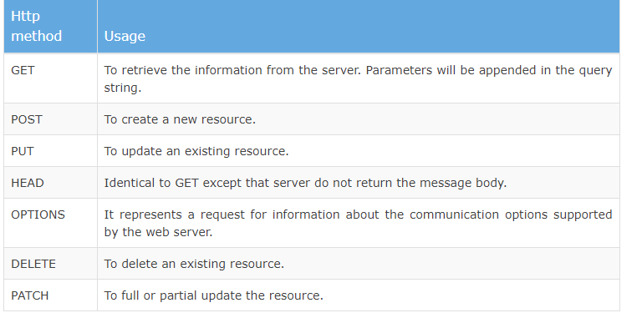
Action Verb/ HTTP Request Methods

Slide 16
GET Method
GET is used to request data from a specified resource.
GET requests can be cached
GET requests remain in the browser history
GET requests can be bookmarked
GET requests should never be used when dealing with sensitive data
GET requests have length restrictions
GET requests are only used to request data (not modify)

Slide 17
POST Method
POST is used to send data to a server to create/update a resource.
POST requests are never cached
POST requests do not remain in the browser history
POST requests cannot be bookmarked
POST requests have no restrictions on data length

